Slide 1
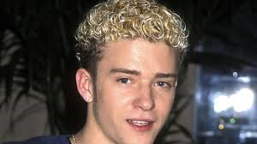
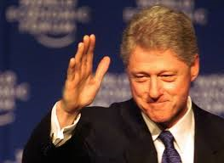
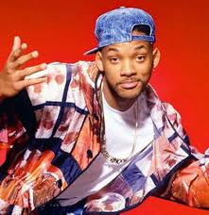
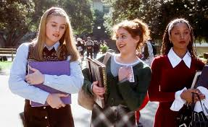
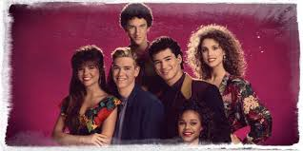
THE 1990S!

Slide 2
US Economy
Bush inherited a growing deficit and a slowing economy
Recession begins: companies began to layoff workers
Bush broke his campaign pledge and agreed to a tax increase.

Slide 3
Extending Rights
Americans with Disabilities Act 1990 forbids any discrimination in workplace and in public places.
Access ramps were added to building, closed captioned television became more commonplace, wheelchair lifts installed on city busses

Slide 4
Persian Gulf War
1990 Iraq’s dictator, Saddam Hussein invades Kuwait.
US worried he would also invade Saudi Arabia
US and UN imposed sanctions and ordered Hussein to withdrawal troops: Iraq refused
1991: Operation Desert Storm: Less than 300 coalition troops were killed; 100 hours after ground war began, US declares victory-Kuwait liberated, Iraq accepts the coalition’s cease-fire terms.

Slide 5
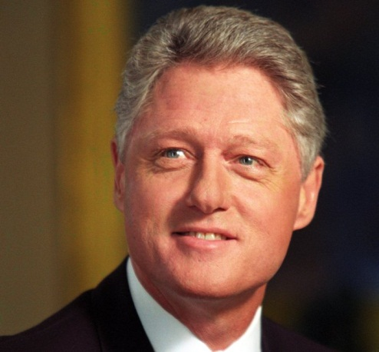
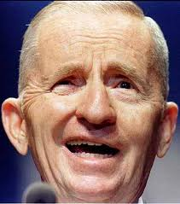
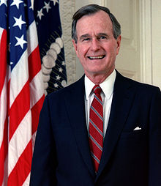
1992 Election
Bush (R) v. Clinton (D) v. Ross Perot (I=3rd party)
Grassroots movement (groups of people organizing at the local level) put forth Ross Perot as their candidate.
Bill Clinton wins election
Perot criticized Bush’s economic policy
Having a 3rd candidate took votes away from Bush.

Slide 6
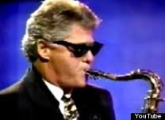
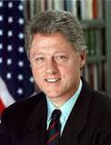
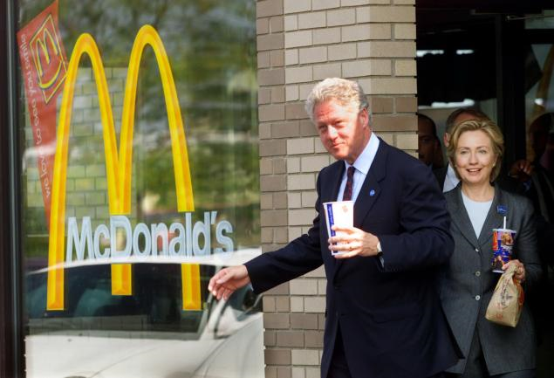
The Clinton Years
William Jefferson Clinton (Democrat)
3rd youngest US President
1993-2001 (served 2 terms)

Slide 7
Democrats take back the presidency:
Clinton focused on 6 things:
High deficit
Economy
Family
Education
Crime
Health care- attempted to make employers pay, but it did not pass

Slide 8
NAFTA
NORTH AMERICAN FREE TRADE AGREEMENT
Reduced trade restrictions to encourage economic growth
USA, Canada, Mexico (aka “North America”)
NAFTA and WTO (formally GATT) increased international trade and globalization

Slide 9
1994: CONTRACT WITH AMERICA:
Promises by Republicans during the 1994 mid-term election.
Contract With America – Promises a better run government
Leads to a conservative resurgence (comeback) during Clinton years

Slide 10
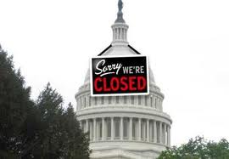
(1995) the Senate and House had a Republican majority, tried to force Clinton into balancing the budget their way
Clinton refused to back down
Result- federal government shutdown, the two sides start to negotiate

Slide 11
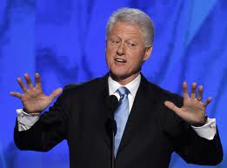
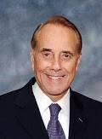
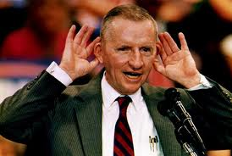
1996 Election:
Clinton-D
Bob Dole- R
Ross Perot- Reform Party (3rd party again stole votes)
WINNER

Slide 12
Clinton wins 2nd term
He took credit for the booming economy
By 1998, the government actually has a SURPLUS! It took in more $$ than it spent
He gave tax cuts for attending college
Expanded the head start program

Slide 13
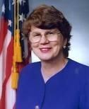
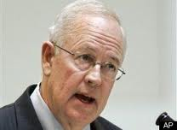
The Big Scandal
Clinton was investigated for arranging illegal loans for an Arkansas real estate company in the early 90s
Attorney General Janet Reno appointed retired federal judge Kenneth Starr to investigate the issue

Slide 14
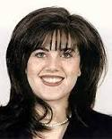
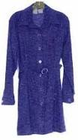
While investigating they discovered a new scandal
He had a “personal” relationship with a Whitehouse intern named Monica Lewinski.
He was asked under oath about the nature of his relationship and lied about it.
He was charged with perjury and obstruction of justice

Slide 15
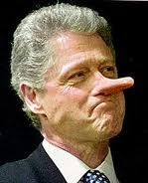
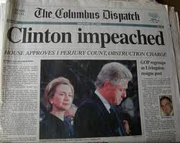
TO IMPEACH OR NOT ?
On Dec. 19, 1998 the House of Representatives voted to impeach Bill Clinton, so it went to the Senate
The Senate voted:
55 to 45 guilty for perjury
50 to 50 guilty of obstruction of justice
Did not have a 2/3 majority, so he was not removed from office
YET AGAIN, THE PUBLIC’S TRUST IN GOVERN-MENT WAS DIMINISHED

Slide 16
Foreign Affairs:
Clinton helped end the civil war in the Balkans (former Yugoslavia) by getting NATO involved in 1996
1998- Kosovo- NATO also used again- Serbia decided to back down after being bombed in 1999
Tensions in the Middle East increase

Slide 17
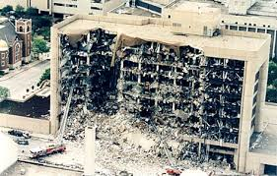
International Terrorism
World Trade Center failed basement bombing attack (1993)
U.S. embassy in Kenya and Mozambique attacked (1998)
USS Cole attacked in Yemen (2000)
Domestic Terrorism
Oklahoma City Bombing (1995)
Atlanta Olympic Park bombing (1996)

Slide 18
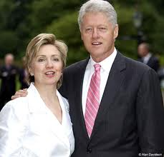
Clinton leaves office
He balanced the budget
Generated great economic growth
Divided the US between liberal and conservative though due to his impeachment trial
His wife, Hillary, is still very active in politics- she just finished serving as Obama’s Secretary of State… Hillary for President 2016??

